Slide 1
W
hat is
,
W
oT
JSON in Practice
Notes:
In the last video, we showed mostly primitive types of JSON. In this video, we will focus on first arrays and objects, and then we will mention common mistakes when writing JSON. At the end of the video, we will demonstrate the usage of JSON generation and parsing.

Slide 2
JSON Array

Slide 3
JSON Array
Number
String
True
Null
[ 28 , "Web of things" , true , null ]
Item
Notes:
In JSON, each value in an array is called an item.
Arrays with items of different types are also allowed.

Slide 4
Nested Object

Slide 5
{
"type": "Humidity Sensor",
"lastCalibration": null,
"measurement": {
"value": 60,
"unit": "Percent"
},
"isActive": true
}
Inner Object
Outer Object
Nested Object
Notes:
Nested objects are allowed in JSON. “measurement” keyword is an example of this.
Objects start and end with a curly brackets. It is basically defining keywords and mapping these keywords to values.
In this example, we define the name and value pairs to describe the data sent by sensors.

Slide 6
[
{
"type": "Temperature Sensor",
"lastCalibration": "2018-11-13T20:20:39+00:00",
"measurement": {
"value": 25,
"unit": "Celsius"
},
"isActive": true,
"precision": 0.1
},
{
"type": "Humidity Sensor",
"lastCalibration": null,
"measurement": {
"value": 60,
"unit": "Percent"
},
"isActive": true
},
{
"name": "Brightness Sensor",
"lastCalibration": "2020-01-19T20:20:35+00:00",
"measurement": {
"value": 2,
"unit": "Lux"
},
"isActive": false
}
]
Object
Array
Object
Object
Notes:
There is a JSON array of JSON Objects which means all items are JSON objects in that array.

Slide 7
Common Mistakes
Notes:
Now we will talk about common mistakes while writing JSON files.

Slide 8
Space " " is a Character
Another
Character
=
=
"isActive"
"isActive "
"isActive"
"isactive"
Notes:
Let's start with the space character which frequently overlooked.
Space is a character too. So “isActive” is not the same as “isActive ”
Also JSON is case sensitive Thus, «isActive» with upper case A is not the same as “isactive” with lower case «a»
Paying attention to this is important to make sure that object assignments and comparisons work.

Slide 9
Another
Character
=
=
"isActive"
"isActive "
"isActive"
"isactive"
"name: "Web of Things"
Case Sensitive
Notes:
Let's start with the space character which frequently overlooked.
Space is a character too. So “isActive” is not the same as “isActive ”
Also JSON is case sensitive Thus, «isActive» with upper case A is not the same as “isactive” with lower case «a»
Paying attention to this is important to make sure that object assignments and comparisons work.

Slide 10
=
"isActive"
"isactive"
"name: "Web of Things"
"isActive": "true"
Forgetting Quotation Marks
Notes:
Lets continue with the mistakes about quotation marks
Forgetting quotation marks is wrong, it will show validation errors everywhere.
Also putting them when you should not cause unwanted results
For example → “name”:”true” is not the same as “name”:true without quotation marks.
The first one is not a boolean but a string so it will be interpreted as a string. The same problem happens with numbers too.
This way, the types will be correctly interpreted by your programming language.

Slide 11
"name: "Web of Things"
"isActive": "true"
"value": "90"
Adding Unneccessary Quotation Marks
Notes:
Lets continue with the mistakes about quotation marks
Forgetting quotation marks is wrong, it will show validation errors everywhere.
Also putting them when you should not cause unwanted results
For example → “name”:”true” is not the same as “name”:true without quotation marks.
The first one is not a boolean but a string so it will be interpreted as a string. The same problem happens with numbers too.
This way, the types will be correctly interpreted by your programming language.

Slide 12
{
"type": "Humidity Sensor",
"lastCalibration": null,
//Here is a comment
"isActive": true
}
"isActive": "true"
"value": "90"
Adding Unneccessary Quotation Marks
Notes:
Lets continue with the mistakes about quotation marks
Forgetting quotation marks is wrong, it will show validation errors everywhere.
Also putting them when you should not cause unwanted results
For example → “name”:”true” is not the same as “name”:true without quotation marks.
The first one is not a boolean but a string so it will be interpreted as a string. The same problem happens with numbers too.
This way, the types will be correctly interpreted by your programming language.

Slide 13
Comments are not Valid
{
"type": "Humidity Sensor",
"lastCalibration": null,
//Here is a comment
"isActive": true
}
"value": "90"
Notes:
Putting comments inside JSON documents is not valid contrast to most of the programming languages.

Slide 14
Trailing Commas
.json file
.js file
{
"type": "Humidity Sensor",
"lastCalibration": null,
"isActive": true,
}
let myVal = {
"type": "Humidity Sensor",
"lastCalibration": null,
"isActive": true,
}
Not Okay
Okay (Tolarated)
Notes:
Commas should not be used at the final name-value pair.
That is why the first one is not valid but difficult to see if you are using it inside of a javascript editor rather than a JSON editor.

Slide 15
Programming Language Syntax
.json file
.js file
{
"type": "Humidity Sensor"
}
let myVal = {
type: "Humidity Sensor"
}
Notes:
Similar to the previous one depending on the programming language that you use syntax might differ. Since JSON will be the object of that programming language before it is parsed and serialized as JSON.
For example, in JSON key-value pairs have to be with quotation marks whereas in JavaScript files it is not necessary to have quotation marks, both work.

Slide 16
Programming Language Syntax
JSON & Rust &
JavaScript & Golang
Python
{
"additionalProperties": true
}
{
"additionalProperties": True
}
Notes:
The syntax of the keywords might differ as well. For example, true false keywords in JSON, Rust, JavaScript, and Golang are written lowercase while in Python the first letter of these keywords needs to be capitalized.

Slide 17
Programming Language Syntax
JSON & JavaScript
Python
{
"temperatureSensor": null
}
{
"temperatureSensor": None
}
Notes:
Similar to the previous one, the null keyword differs in JSON and Python. In JSON and JavaScript it is null with lowercase while in Python, the same meaning is given with the «None» keyword.

Slide 18
1 JSON Generation
1.a JSONı filesysteme kaydet Js
1.b JSONı bir yere yollamak Python Request lib
2. JSON Parsing
2.a file system dan bir JSON read file.read py
Arrayin içindeki activlerin print edilmesi ???

Slide 19
JSON GENERATION
Saving JSON to file system
Sending JSON to some URL
JSON PARSING
Reading a JSON file From file system
Printing the read JSON file

Slide 20

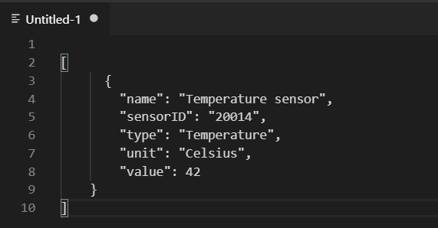
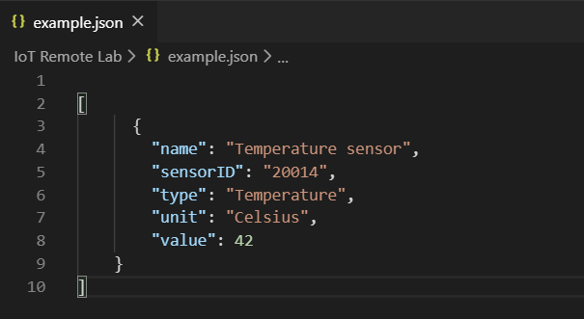
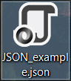
Saving to File System as .json
Notes:
Open a code editor. In this example, we used VS Code. Write a JSON file of your choice and save it by giving a file name and adding a .json extension. Then the editor will recognize the file as a JSON document.

Slide 21
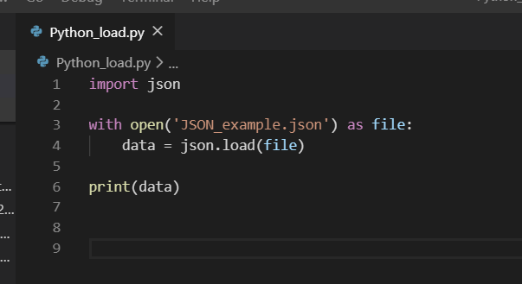
Reading And Printing JSON File From File System
json library
Notes:
Now we will read a JSON file from the file system using a JSON library in Python. We open the JSON file that we have previously saved to the file system with open-as-file key words. Then, we can load that JSON file with the load function into the data object. We can also print it to see what is inside the JSON file.

Slide 22
Reading And Printing JSON File From File System
Output
[{'name': 'Temperature sensor', ‘sensorID': '20014’,
'type': 'Temperature', 'unit': 'Celsius', 'value': 42}]
Notes:
Printing the data object in console can look like this.

Slide 23
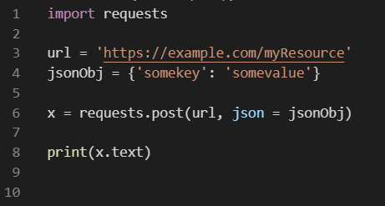
Sending JSON File as an HTTP request
request library
Notes:
There are many ways to send a JSON file via different protocols, one of them is using Python and its request library for sending an HTTP request. With this library, you can use the post function to send an HTTP POST request with a JSON Payload. As a parameter, it takes the URL to send to and the JSON object.

Slide 24


JSON
JSON
in Practice
NEXT VIDEO
JSON
Schema
JSON
Schema
in Practice
Notes:
In the next video, we will talk about JSON Schema.

